Slide 1
Insurance Claim Severity Regression Analysis
Karim Al Zeer Alhusaini
Nalini Kethineni

Slide 2
Goal
Use machine learning techniques to predict monetary loss on an auto insurance claim
Automate the process of assessing claim severity

Slide 3
Data set
Allstate 2016 Kaggle Competition
Anonymized data set
No NA or Null values
188,318 instances each representing an insurance claim
130 features
Feature Type | Count
Categorical | 116
Continuous | 14

Slide 4
Data set
65 % Training
20 % Validation
15 % Testing
Target Variable | Numeric continuous representing dollar loss value

Slide 5
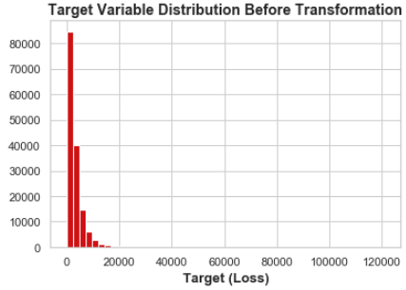
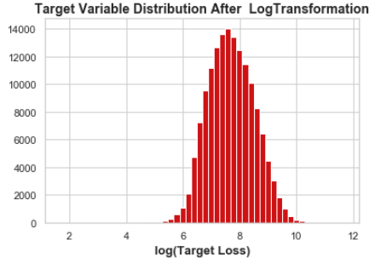
Exploratory data analysis
Target variable transformation

Slide 6
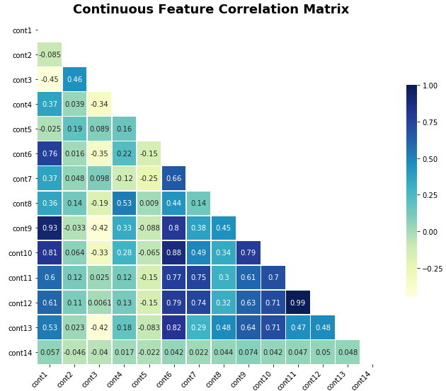
Correlation Matrix
Removed highly correlated features

Slide 7

Loss Metric
Mean Absolute Error (MAE)
$$MAE=\frac{1}{n}\sum_{i=1}^{n}{\left|y_{i} − {\hat{y}}_{i}\right|}$$

Slide 8

Feature encoding
One-Hot Encoding
$$var:\left[A,B,B,C\right]= var_{A}: \left[1,0,0,0\right],var_{B}: \left[0,1,1,0\right],var_{C}: \left[0,0,0,1\right]$$
Multi-label Encoding
$$var:\left[A,B,B,C\right]=var:\left[1,2,2,3\right]$$

Slide 9
Models
Multiple Linear Regression: 65% Adjusted R-Squared
Regularization methods
Ridge: 69% Adjusted R-Squared
Lasso: 69% Adjusted R-Squared
Principal Component Regression: 75% Adjusted R-Squared
Support Vector Machines (Regressor)
Random Forest
Multi-Layer Perceptron (Neural Network)

Slide 10
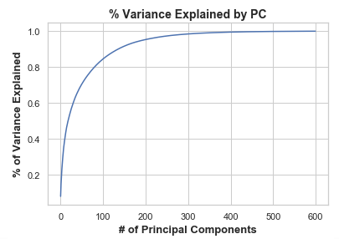
Dimensionality Reduction
One-Hot Encoding yields a high dimensional data set
1190 Features
Dimensionality reduction using Principal Component Analysis

Slide 11
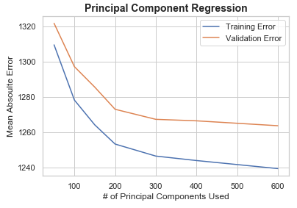
Principal component Regression

Slide 12
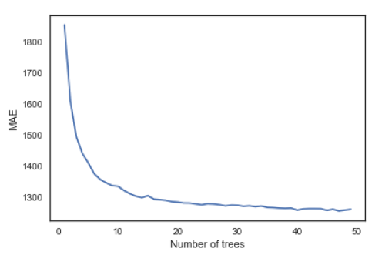
Random forest
Good results on training set
Tends to overfit

Slide 13
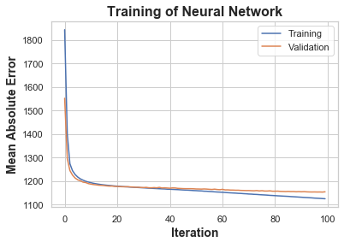
Neural Network
Simple Feed-Forward Network
Using Backpropagation algorithm
Single hidden layer
500 Neurons
ReLU activation function
‘Adam’ optimizer
128 batch size
100 Epochs

Slide 14
Results
Model | Training MAE | Test MAE
Linear Regression | 1299 | 1312
PC Regression | 1240 | 1265
Ridge Regression | 1287 | 1302
Lasso Regression | 1286 | 1302
Support Vector Regressor | 1296 | 1308
Random Forest | 467 | 1251
Neural Network (MLP) | 1125 | 1154

Slide 15
Further analysis
Apply hyper parameter tuning on SVM, MLP models
Explore advanced ensemble methods, e.g. XGBoost

Slide 16
Thank you
Questions?

